Slide 1
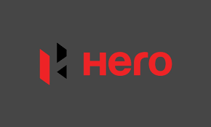
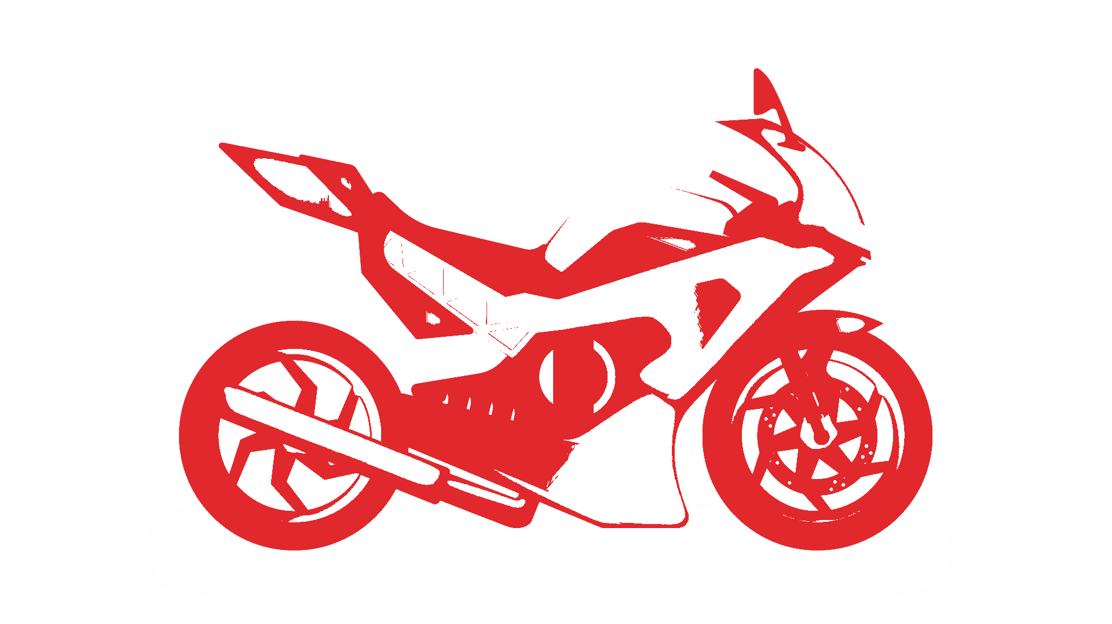
Hero motocrop.ltd
Presented by
M.Sai lakshmi
Y.Deepthi
T. Divya
K.hemambari

Slide 2


Introduction
Hero motor corporation limited
Industry | Automotive
Founded | 19 January 1984; 39 years ago
Founder | Brijmohan Lall Munjal
Headquarters | New Delhi, India
Key people | Pawan Munjal (Chairman, MD & CEO)^{[1]}
Products | Motorcycles Scooters

Slide 3
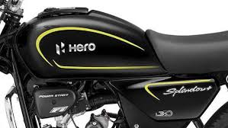
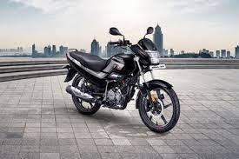
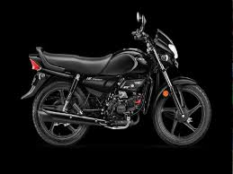
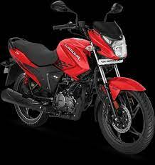
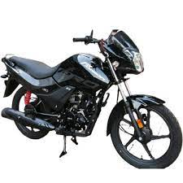
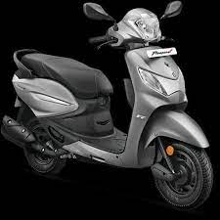
Popular models of HERO
02
03
04
05
06
Hero Splendor Plus
Hero Super Splendor
Hero HF Deluxe
Hero Glamour
Hero Passion Pro
Hero Pleasure

Slide 4



Mission & values of HERO
Hero motoCorp’s mission is to become a global leader in the two-wheeler industry by providing sustainable mobility services.
Their core values typically include innovation,sustainability,customer focus,integrity and excellence .
Hum Mein Hai Hero

Slide 5
USP of Hero Motocrop.ltd
The Unique Selling Proposition (USP) of Hero MotoCorp, a major motorcycle and scooter manufacturer, has traditionally been its focus on producing reliable and affordable two-wheelers for the mass market. Hero is known for:
1. Fuel Efficiency: Hero bikes and scooters are often praised for their excellent fuel efficiency, making them cost-effective for everyday commuters
2. Extensive Network: Hero has a vast network of dealers and service centers, ensuring widespread availability and after-sales support
3. Wide Product Range: They offer a diverse range of models, catering to various customer needs, from basic commuter bikes to more stylish and performance-oriented options.
4. Strong Brand: Hero has a strong presence and brand reputation in the Indian and global markets, instilling trust in consumers.
5. Competitive Pricing: Hero aims to keep its products competitively priced, making them accessible to a broad range of consumers.

Slide 6
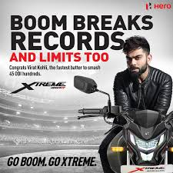
Brand tone & identity
Hero MotoCorp, one of the largest motorcycle manufacturers in the world, typically maintains a brand tone that is customer-centric, reliable, and focused on innovation and sustainability. They emphasize qualities like trustworthiness, performance, and a commitment to providing eco-friendly mobility solutions. Their messaging often revolves around empowering customers and creating a better, more sustainable future for mobility.
Hero MotoCorp is an Indian multinational motorcycle and scooter manufacturer. It is based in New Delhi, India. The company was formerly known as Hero Honda, a joint venture between the Hero Group of India and Honda of Japan. However, in 2011, Hero MotoCorp became an independent entity after the Hero Group bought out Honda's stake in the joint venture. The company is known for producing a wide range of motorcycles and scooters popular in the Indian market and beyond.

Slide 7
Smart goals and kpi’s
Smart goals
KPI’S
Increase Market Share: Achieve a 5% increase in market share within the next two years. .Enhance Product Innovation :Launch at least two new innovative motorcycle models within the next year
Improve Customer Satisfaction Increase the Net Promoter Score (NPS) by 10 points in the next 12 months.
Expand into New Markets:-Enter two new international markets within the next three years.
Boost Employee Productivity: Increase productivity by 20% over the next year through training and development.
Sales Volume:Tracking the number of motorcycles sold over a specific period, often measured monthly, quarterly, and annually.
Market Share: Measuring the company's share of the motorcycle market in various regions and segments.
Revenue and Profit Margins: Monitoring the company's total revenue and profit margins to assess financial health
Customer Satisfaction Index (CSI): Gathering customer feedback to evaluate the level of satisfaction with the products and services
Warranty Claims and Returns: Tracking the number of warranty claims and product returns as an indicator of product quality.

Slide 8
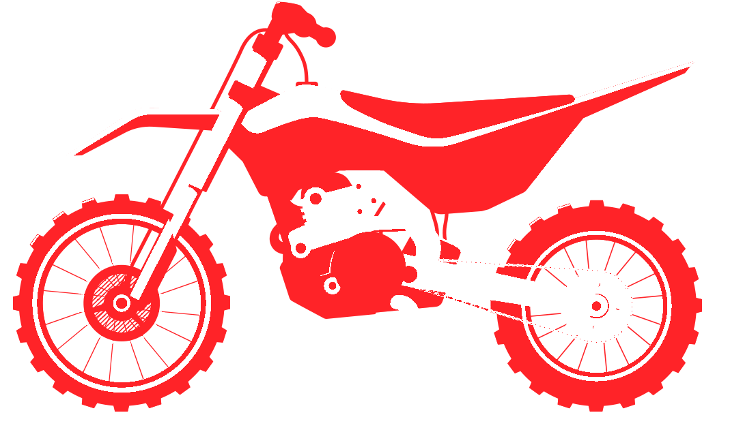
Buyers /audience persona
Hero MotoCorp is a popular motorcycle manufacturer, and their target buyers and audience typically.
Commuters: Hero motorcycles are known for their fuel efficiency and reliability, making them a popular choice for daily commuters. Budget-Conscious Consumers: Hero offers a range of affordable and cost-effective motorcycles, making them appealing to those looking for value for money
Two-Wheeler Enthusiasts: Some Hero models cater to motorcycle enthusiasts who appreciate features and performance in addition to practicality.
Heritage and Legacy Hero MotoCorp has a rich history dating back to 1984 when they started as a joint venture with Honda. They are known for pioneering the two-wheeler industry in India.
Market Leader: Hero MotoCorp has consistently been a market leader in India and other countries, known for producing a wide range of motorcycles and scooters to cater to diverse customer needs
Commuter Focus: A significant portion of their product lineup is designed for daily commuting, emphasizing fuel efficiency, affordability, and reliability.
Innovation: Hero has been at the forefront of technological innovation in the motorcycle industry, with features like the i3S system for idle-stop-start technology and the Hero Eco app for electric scooters.

Slide 9



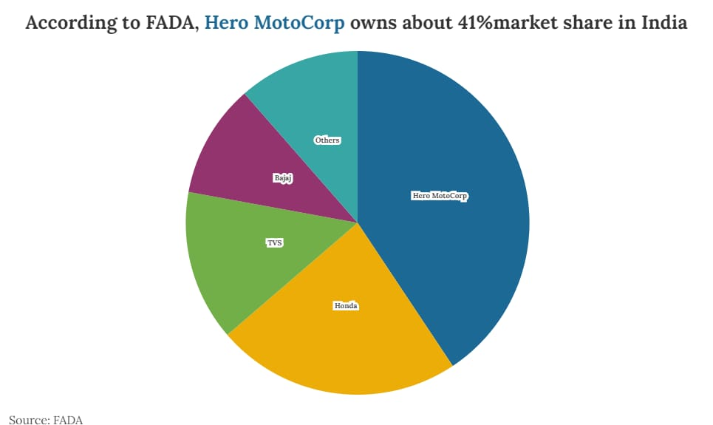
Competitors of HERO
market share at 18.2%, 61.5% respectively)
90% share of the market
Market share: 31.81%, down from 35.65% in April-June 2022
35.5% of the market share.

Slide 10

COMPETITOR ANALYSIS OF HERO
STRENGTHS
WEAKNESS
Diverse Product Portfolio: Bajaj offers a wide range of two-wheelers, including motorcycles, scooters, and three-wheelers, catering to various market segments.
Market Dependence :Bajaj revenue heavily relies on the Indian making it vulnerable to domestic economic fluctuations.2. Intense Competition: The two-wheeler industry is highly competitive, both in India and globally.
OPPORTUNITIES
THREATS
Expanding into emerging markets in Asia, Africa, and Latin America can lead to further growth.
Regulatory Changes: Changes in emissions standards, safety regulations, and trade policies can impact the company's operations.

Slide 11

STRENGTHS
WEAKNESS
Royal Enfield has a rich heritage and a distinctive brand image associated with classic, retro-styled motorcycles.
Royal Enfield primarily focuses on mid-sized motorcycles, which limits its product range compared to competitors.
OPPORTUNITES
THREATS
The growing demand for electric motorcycles presents an opportunity for Royal Enfield to expand its product portfolio.
Royal Enfield faces competition from both established and emerging motorcycle manufacturers in India and international markets.

Slide 12
STRENGTHS
WEAKNESS
TVS Motor Company has a well-established and respected brand in the Indian and international motorcycle market.
Facing strong competition from both domestic and international motorcycle manufacturers.
OPPORTUNITIES
THREATS
The growing demand for electric two-wheelers provides an opportunity for TVS to expand its EV offerings.
:Changes in emissions standards, safety regulations, and trade policies can impact the company's operations.

Slide 13
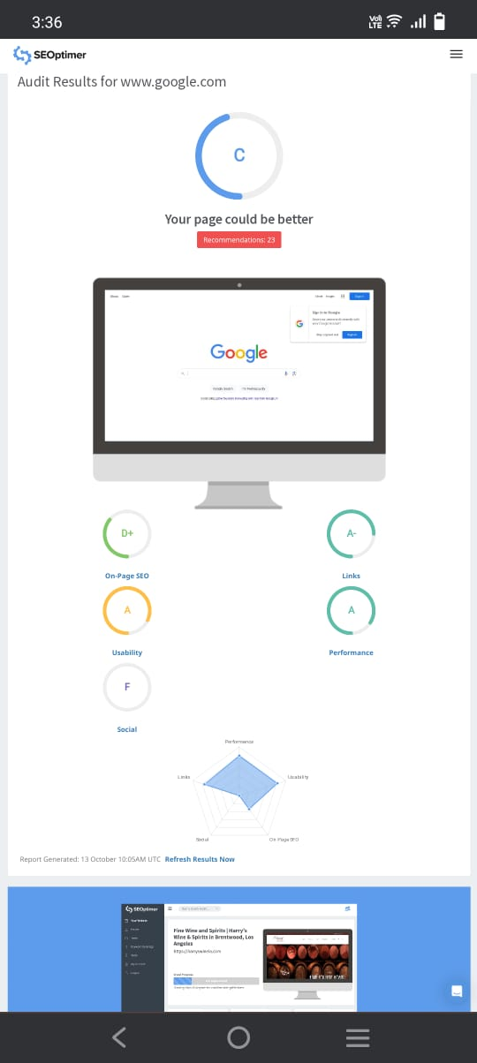
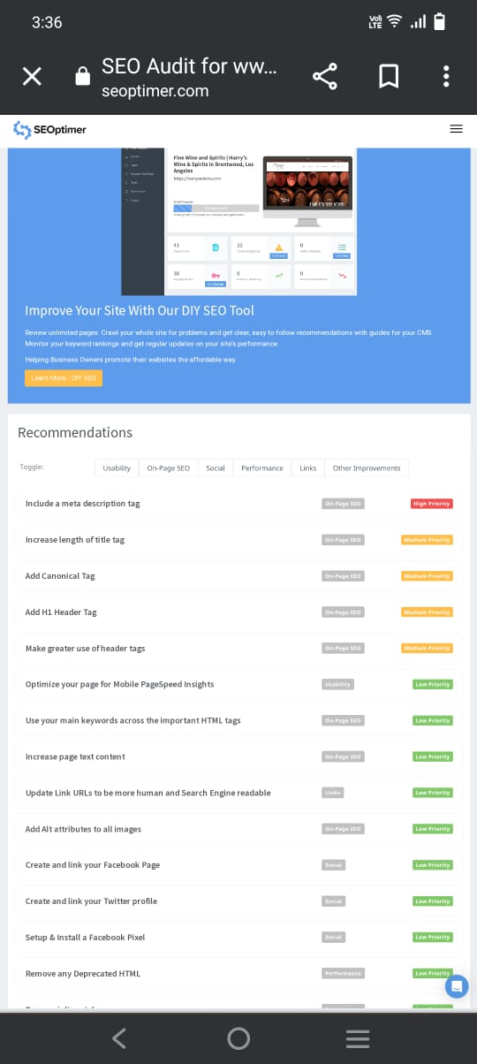
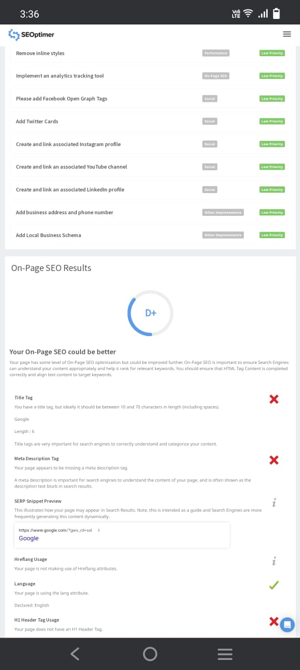
SEO audit

Slide 14
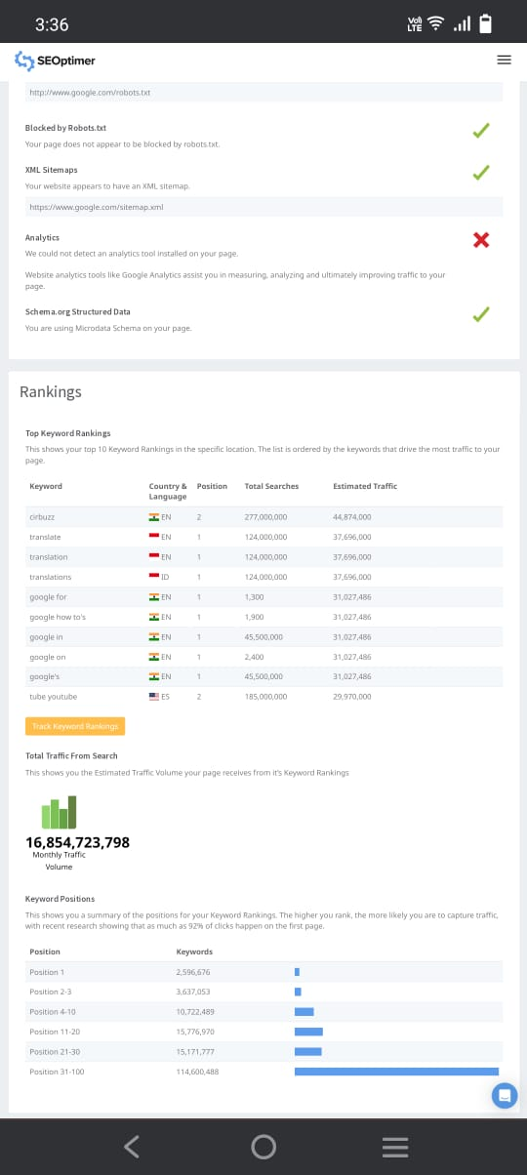
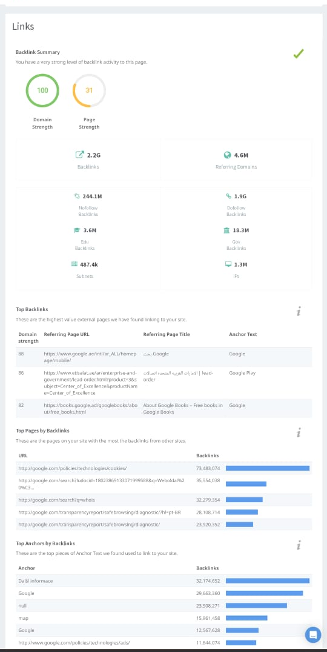
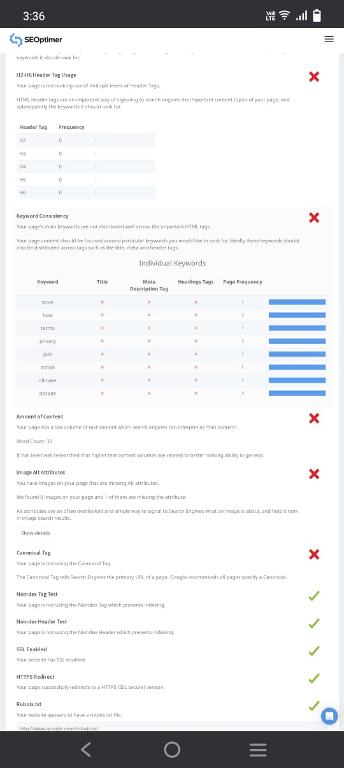

Slide 15
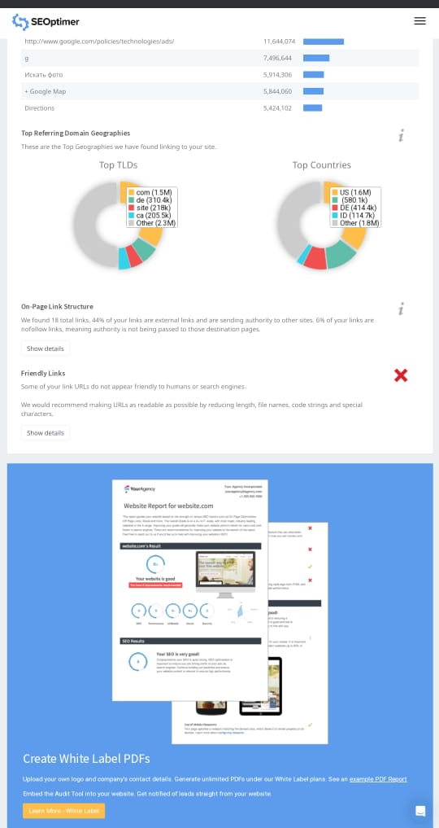
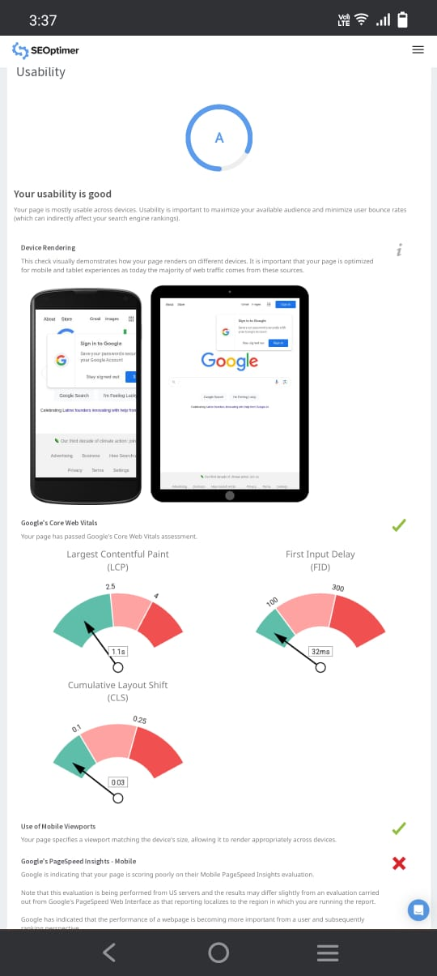
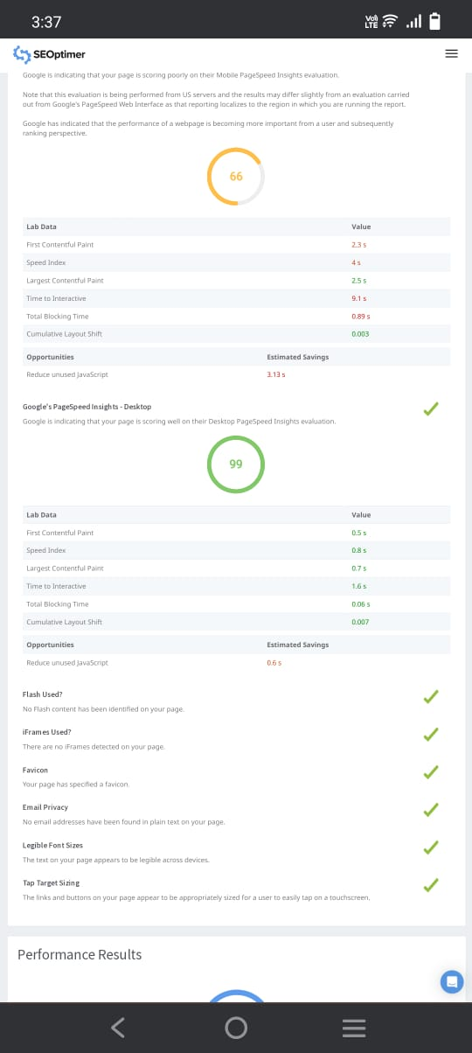

Slide 16
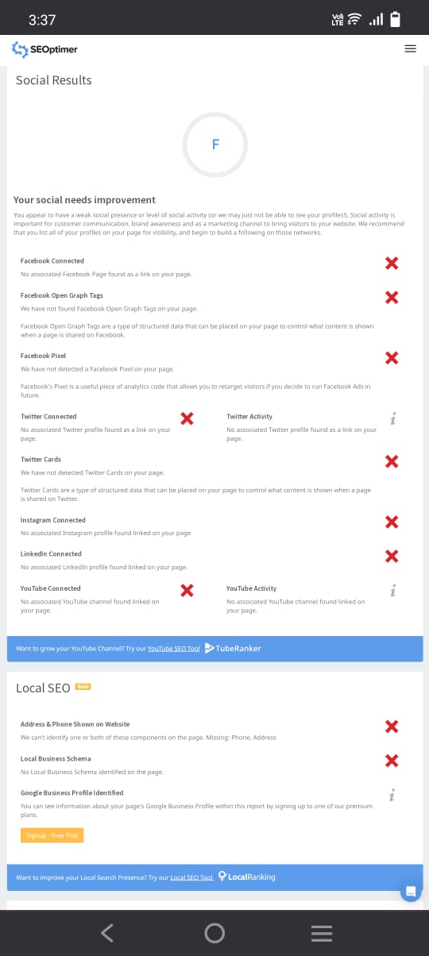
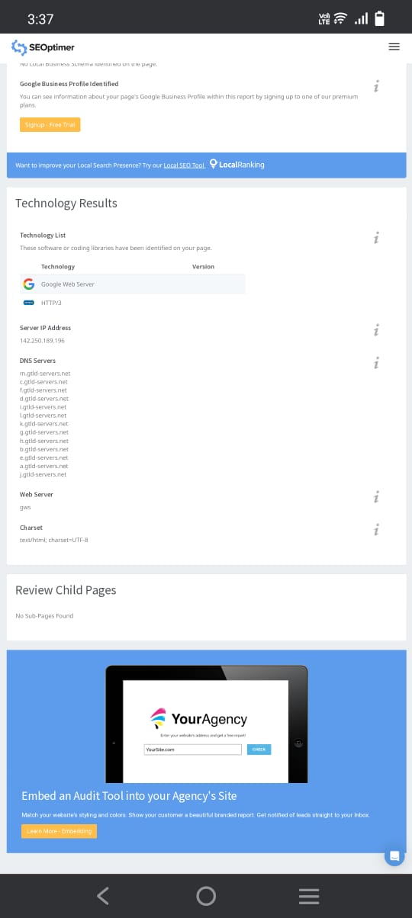

Slide 17
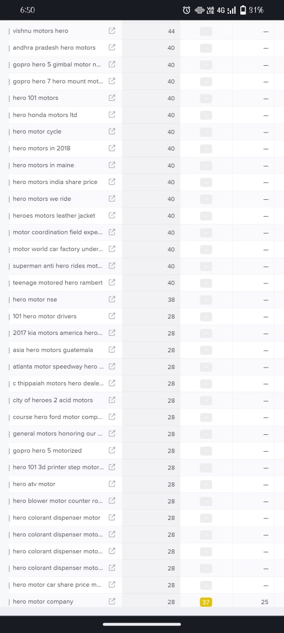
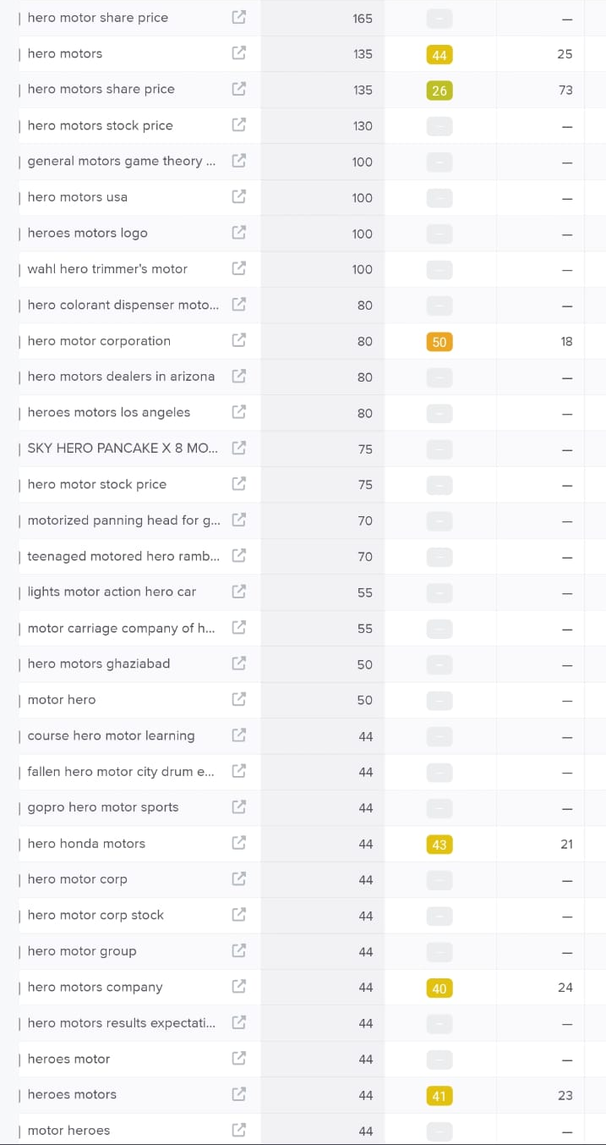
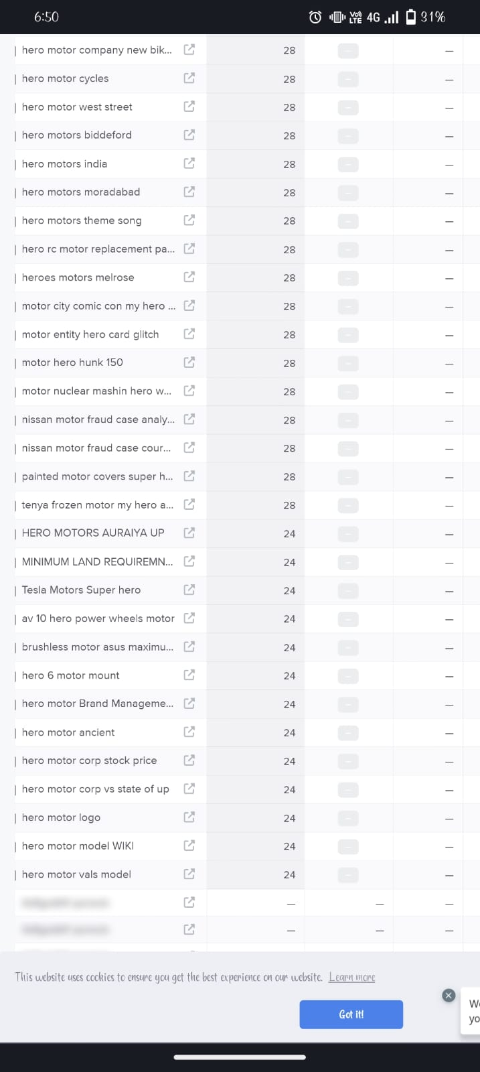
Keyboard research

Slide 18
Content ideas and marketing straegies
1*Educational Blog Posts:* Create blog posts that educate your audience about topics related to your industry or niche. Provide valuable information and insights.
2. *How-to Guides:* Develop in-depth how-to guides or tutorials that help your audience solve common problems or achieve their goals.3
. *Customer Stories:* Share success stories or case studies featuring your satisfied customers. This can build trust and credibility.
4. *Behind-the-Scenes Content:* Give your audience a glimpse behind the scenes of your business. Show the people, processes, and culture that make your brand unique.`11
*Market Research:* Conduct thorough market research to understand customer preferences, emerging trends, and competitors' strategies
.2. *Segmentation and Targeting:* Identify and segment the target audience based on demographics, psychographics, and behavior. Create specific marketing campaigns for each segment
.3. *Product Development:* Continuously innovate and improve motorcycle models to meet customer needs and regulatory standards
.4. *Brand Positioning:* Clearly define the brand's unique value proposition and positioning in the market. Highlight qualities like reliability, fuel efficiency, and affordability.

Slide 19
Content calendar
Sunday 1 | Monday 2 | Tuesday 3 | Wednesday 4 | Thursday 5 | Friday 6 | Saturday 7
8 | 9 | 10 | 11 | 12 New blog | 13 Webinor | 14 Product launch
15 | 16 Updated blogs | 17 Campaign | 18 Twitter chat | 19 E-book | 20 Connecting customers | 21 Curated content
22 | 23 Holiday | 24 Holiday | 25 Holiday | 26 Updates blogs | 27 Facebook posts ,reels | 28 Instagrams reels,stories
29 | 30 Customers Connections | 31 Employee connection

Slide 20
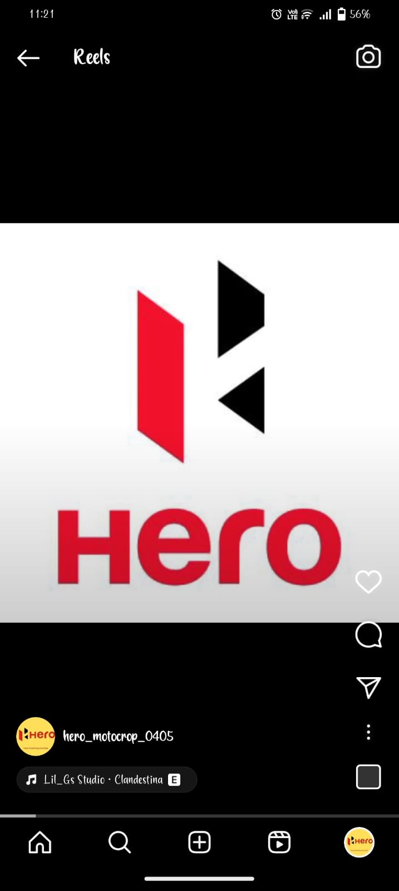
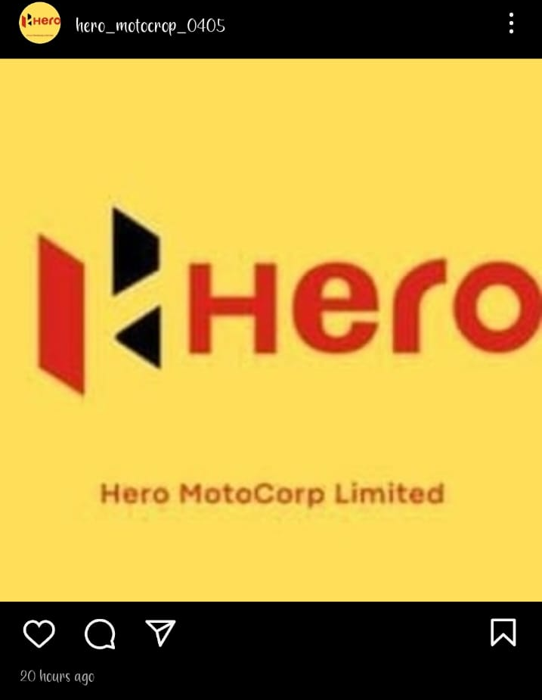
Instagram stories

Slide 21
Instagram link
https://www.instagram.com/reel/CyVeCupPMu2/?igshid=MmU2YjMzNjRlOQ==heromotocrop

Slide 22
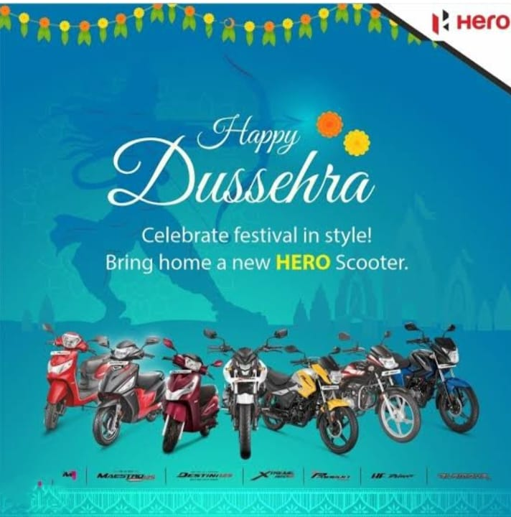
Poster of hero motocrop

Slide 23
Thanks……

